Slide 1
Yes
NO
Finding
Yeses

Slide 2
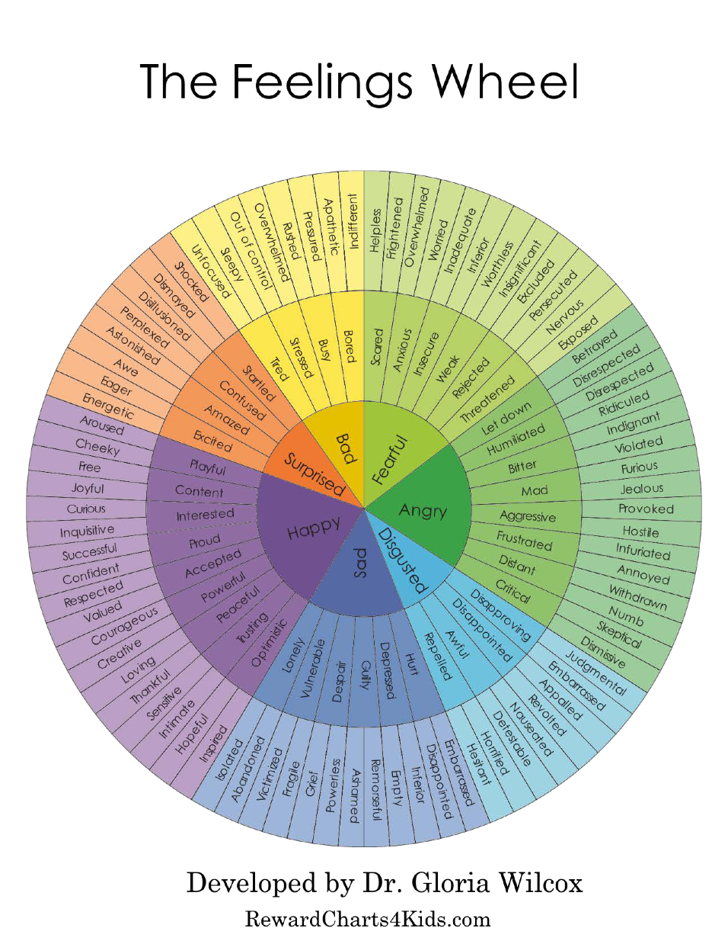
Yes
NO
Finding
Yeses

Slide 3
Happy
Yes
Negative
Angry
NO
Finding
Yeses
Fearful
Sad
Disgusted

Slide 4
Impossible -> possible
Frequent -> seldom
Intense -> subtle
Always <=> Never

